Slide 1
DSA With C++

Slide 2
Unit 1
Introduction to Components of a Computer System: Memory, Processor, I/O Devices, Storage, Operating System, Concept of Assembler, Compiler, Interpreter, Loader and Linker. Idea of Program/Algorithm: Representation of Algorithms - Flowchart, Algorithm, Visualization of Flowchart/Algorithm using Raptor tool, From Algorithms to Programs, Source Code. Programming Basics: Writing and Executing the First C++ Program, Syntax and Logical Errors in Compilation with Examples. Object and Executable Code, The Structure of a C++ Program, The main function, Header Files, Standard Output/Input, and Comments.

Slide 3
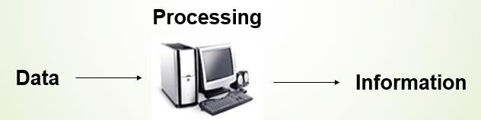
What Is Computer?
The word computer comes from the word “compute”, which means, “to calculate”.
Computer receives input, stores or processes the input as per user instructions and provides output in desired format.

Slide 4
Classification of Computer
A Computer can be classified on the basis of various categories namely-
Based on Purpose
General Purpose Computer
Special Purpose Computer
Based on Technology used
Analog Computer
Digital Computer
Hybrid Computer
Based on Size and Capacity
Micro Computer
Mini Computer
Super Computer

Slide 5
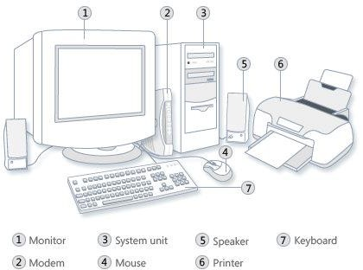
Two primary components
Hardware : Computer hardware is the collection of physical elements that constitutes a computer system.

Slide 6
Two primary components
2. Software: Software is a generic term for organized collections of computer data and instructions, often broken into two major categories:
System software that provides the basic non- task-specific functions of the computer, and
Application software which is used by users to accomplish specific tasks.

Slide 7
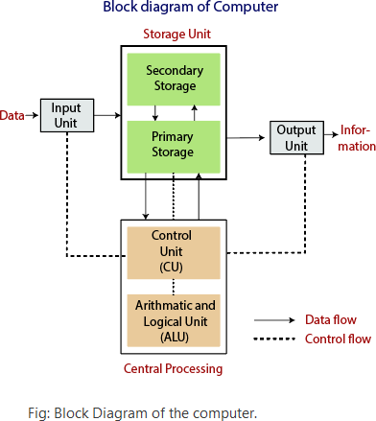
Block diagram of Digital computer
Block diagram of a computer gives you the pictorial representation of a computer that how it works inside. Or you can say that, in computers block diagram, you will see how computer works from feeding the data to getting the result.

Slide 8
Working of Digital Computer
The data is entered through input devices such as the keyboard, mouse, etc.
The set of instruction is processed by the CPU after getting the input by the user, and then the computer system produces the output.
The computer can show the output with the help of output devices to the user, such as monitor, printer, etc.

Slide 9
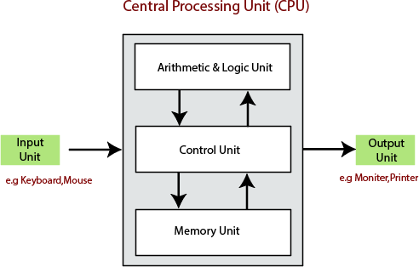
Components of Digital Computer
1. Central Processing Unit (CPU)
The computer system is nothing without the Central processing Unit. So, it is also known as the brain of computer. The CPU is an electronic hardware device which can perform different types of operations such as arithmetic and logical operation.

Slide 10
Components of Digital Computer
The CPU contains two parts: the arithmetic logic unit and control unit.
1.Control Unit : The control unit (CU) controls all the activities or operations which are performed inside the computer system. It receives instructions or information directly from the main memory of the computer.
2. Arithmetic and Logical Unit : The arithmetic and logical unit is the combinational digital electronic circuit that can perform arithmetic operations on integer binary numbers. It presents the arithmetic and logical operation. The outputs of ALU will change asynchronously in response to the input. The basic arithmetic and bitwise logic functions are supported by ALU.

Slide 11
Components of Digital Computer
3. Input Devices
The user provides the set of instruction or information to the computer system with the help of input devices such as the keyboard, mouse, scanner, etc.
4. Output Devices
The output devices produce or generate the desired result according to our input, such as a printer, monitor, etc. These devices convert the data into a human-readable form from binary code.

Slide 12
Components of Digital Computer
5. Storage Unit : The information or set of guidelines are stored in the storage unit of the computer system. The storage unit provides the space to store the data or instruction of processed data. The information or data is saved or hold in computer memory or storage device. The data storage is the core function and fundamental of the computer components.
There are mainly two types of storage Unit-
Primary Storage
Secondary Storage

Slide 13
Components of Digital Computer
i) Primary memory is the main memory of computer system. The instructions that have to be currently executed is copied to the primary memory because CPU can directly access the data from primary memory.
Primary memory can be divided into two types of memory that are
RAM (Random Access Memory) and
ROM (Read Only Memory).
ii) Secondary storage are also called as permanent storage unit as when the data store in this memory are stored permanently user can recall the data whenever they need. The data remains in this memory even when there is a power failure or shutdown, they are much more cheaper then primary memory.
The Example of Secondary Storage are Hard disk and Zip drives.

Slide 14
Components of Digital Computer
i) Primary memory is the main memory of computer system. The instructions that have to be currently executed is copied to the primary memory because CPU can directly access the data from primary memory.
Primary memory can be divided into two types of memory that are
RAM (Random Access Memory) and
ROM (Read Only Memory).
ii) Secondary storage are also called as permanent storage unit as when the data store in this memory are stored permanently user can recall the data whenever they need. The data remains in this memory even when there is a power failure or shutdown, they are much more cheaper then primary memory.
The Example of Secondary Storage are Hard disk and Zip drives.

Slide 15
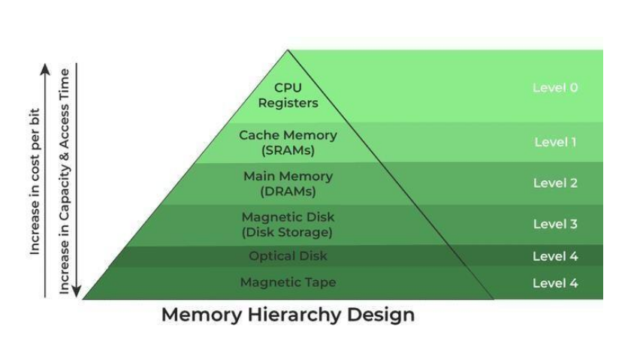
Memory Hierarchy

Slide 16
Characteristics of Memory Hierarchy
Capacity: It is the global volume of information the memory can store. As we move
from top to bottom in the Hierarchy, the capacity increases.
Access Time: It is the time interval between the read/write request and the availability of the data.
Performance: This enhancement was made in the form of Memory Hierarchy Design because of which the performance of the system increases.
Cost Per Bit: As we move from bottom to top in the Hierarchy, the cost per bit increases i.e. Internal Memory is costlier than External Memory

Slide 17
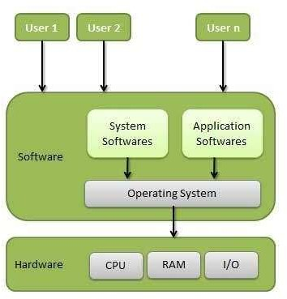
Operating System
An Operating system (OS) is a system software which acts as an interface between the end user and computer hardware. Every computer must have at least one OS to run other programs. An applications like Chrome, MS Word, Games, etc needs some environment in which it will run and perform its task.

Slide 18
Operating System as a Resource Manager
Internally an Operating System acts as a resource manager of the computer system such as processor, memory, files, and I/O device.
In this role, the operating system keeps track of the status of each resource, and decides who gets a resource, for how long and when.

Slide 19
Functions of Operating system
Process management:- Process management helps OS to create and delete processes. It also provides mechanisms for synchronization and communication among processes.
Memory management:- Memory management module performs the task of allocation and de-allocation of memory space to programs in need of this resources.
File management:- It manages all the file-related activities such as organization storage, retrieval, naming, sharing, and protection of files.
Device Management: Device management keeps tracks of all devices. This module also responsible for this task is known as the I/O controller. It also performs the task of allocation and de-allocation of the devices.

Slide 20
Cont..
I/O System Management: One of the main objects of any OS is to hide the peculiarities of that hardware devices from the user.
Security:- Security module protects the data and information of a computer system against malware threat and authorized access.
Networking: A distributed system is a group of processors which do not share memory, hardware devices, or a clock. The processors communicate with one another through the network.
Communication management: Coordination and assignment of compilers, interpreters, and another software resource of the various users of the computer systems.

Slide 21
Types of Operating System
Batch Operating System
Multitasking/Time Sharing OS
Multiprocessing OS
Real Time OS
Distributed OS
Network OS

Slide 22
Types of Operating System
Batch Operating System
Some computer processes are very lengthy and time-consuming. To speed the same process, a job with a similar type of needs are batched together and run as a group.
Multi-Tasking/Time-sharing Operating systems
Time-sharing operating system enables people located at a different terminal(shell) to use a single computer system at the same time. The processor time (CPU) which is shared among multiple users is termed as time sharing.
Real time OS
A real time operating system time interval to process and respond to inputs is very small. Examples: Military Software Systems, Space Software Systems.

Slide 23
Types of Operating System
Distributed Operating System
Distributed systems use many processors located in different machines to provide very fast computation to its users.
Network Operating System
Network Operating System runs on a server. It provides the capability to serve to manage data, user, groups, security, application, and other networking functions.

Slide 24
Types of Computer Language
Computer Language is used to communicate with the computers. It is different from the language that we usually use to communicate.
Computer system is made up off electronic circuits that is either ON or OFF.
Computer Language is divided into 2 types.
→High Level Language
→Low level language.

Slide 25
Low Level Language
Assembly language and binary /machine language are considered to be low level language.
LLL is in the form of 0 and 1,the actual language that computer/machine understands.
Assembly language is one step ahead of low level language. It allows for the symbolic names instead of just numbers like 0 and 1.In this we use English like words, which is easy to understand then machine language.

Slide 26
Low Level Language
Advantage of LLL:-
As it is directly understandable by the machine, processing speed is high.
No translator is required.
It occupies less memory space.
Disadvantages of LLL:-
LLL is difficult to read and write.
2. Difficult to debug.

Slide 27
High Level Language
HLL is more closer to the human language. HLL has its own syntax and Rules which are strictly followed. High level languages are needed to be convert into machine language.
Now a days most of the languages we are using, are High level languages like C, C++, JAVA, Python etc.

Slide 28
High Level Language
Advantages of HLL →
HLL is easy to read and write.
HLL is easy to debug.
Disadvantages of HLL→
Processing speed is slow, as it needs translators.
It occupies more memory space.

Slide 29
Translators
A program written in high-level language is called as source code. To convert the source code into machine code, translators are needed.
A translator takes a program written in source language as input and converts it into a program in target language as output.
It also detects and reports the error during translation.
There are three types of translators.
1. Assembler
2. Compiler
3. Interpreter

Slide 30
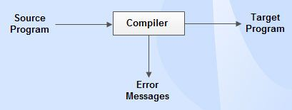
Compiler
Compiler is a translator which is used to convert programs in high-level language to low-level language. It translates the entire program and also reports the errors in source program encountered during the translation.

Slide 31
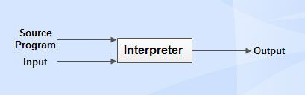
Interpreter
Interpreter is a translator which is used to convert programs in high-level language to low-level language. Interpreter translates line by line and reports the error once it encountered during the translation process.
It directly executes the operations specified in the source program when the input is given by the user.
It gives better error diagnostics than a compiler.

Slide 32
Difference between Compiler and Interpreter
Compiler→
Performs the translation of a program as a whole.
Execution is faster.
Requires more memory as linking is needed for the generated intermediate object code.
Debugging is hard as the error messages are generated after scanning the entire program only.
Programming languages like C, C++ uses compilers.
Interpreter→
Performs statement by statement translation.
Execution is slower.
Memory usage is efficient as no intermediate object code is generated.
It stops translation when the first error is met. Hence, debugging is easy.
Programming languages like Python, BASIC, and Ruby uses interpreters.

Slide 33
Linker
For a code to run we need to include a header file or a file saved from the library which are pre-defined if they are not included in the beginning of the program then after execution the compiler will generate errors, and the code will not work.
Linker is a program that holds one or more object files which is created by compiler, combines them into one executable file. Linking is implemented at both time, load time and compile time. Compile time is when high level language is turns to machine code and load time is when the code is loaded into the memory by loader.

Slide 34
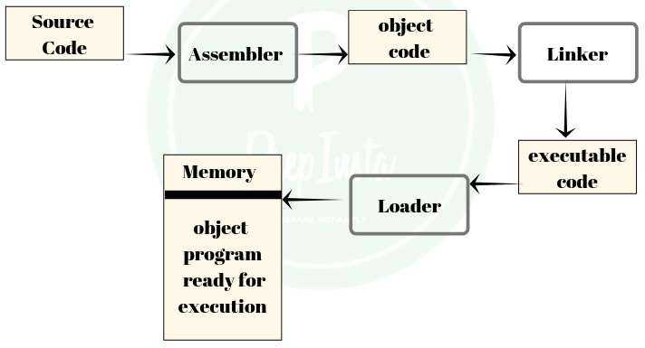
Loader
Loader is a program that loads machine codes of a program into the system memory.
It is part of the OS of the computer that is responsible for loading the program. It is the bare beginning of the execution of a program.
Loading a program involves reading the contents of executable file into memory. Only after the program is loaded the operating system starts the program by passing control to the loaded program code.
All the OS that support loading have loader and many have loaders permanently in their memory

Slide 35
Problem Solving Approach
1. Algorithm-
To write a logical step-by-step method to solve the problem is called algorithm, in other words, an algorithm is a procedure for solving problems.
In order to solve a mathematical or computer problem, this is the first step of the procedure. An algorithm includes calculations, reasoning and data processing. Algorithms can be presented by natural languages.

Slide 36
Algorithm
Characteristics of an Algorithm-
Input- Every algorithm must have zero or more input.
Output- Every algorithm must produce at least one output.
Definiteness- An algorithm must be unambiguous.
Effectiveness- Every algorithm must be clear and precise.
Finiteness- Each algorithm must terminate within finite number of steps.

Slide 37
Example of Algorithm
Write an algorithm to convert temperature from Fahrenheit to Celsius..
Step 1: Read temperature in Fahrenheit
Step 2: Calculate temperature with formula C=5/9*(F-32)
Step 3: Print C

Slide 38
Real Life Problems for Algorithm
Question 1: ATM Withdrawal
Design an algorithm to simulate an ATM cash withdrawal. The algorithm should:
Take the amount to be withdrawn as input.
Check if the balance is sufficient.
If yes, deduct the amount and display the new balance.
If not, display “Insufficient Balance”.
Question 2: Online Food Delivery Bill
Write an algorithm for an online food delivery app that:
Takes the price of the food items as input.
Calculates the total bill.
Adds delivery charges (₹50 if total < ₹500, else free).
Displays the final amount to be paid.

Slide 39
Real Life Problems for Algorithm
Question 3: Temperature Converter
Write an algorithm to convert temperature:
Input temperature in Celsius.
Convert it to Fahrenheit using the formula:
F=(C×9/5)+32F = (C × 9/5) + 32F=(C×9/5)+32
Display the result.
Question 4: Library Fine Calculation
A library charges a fine if books are returned late:
₹2 per day for up to 5 days late.
₹5 per day for 6–10 days late.
₹10 per day for more than 10 days late.
Write an algorithm to calculate the fine based on the number of late days entered by the user.

Slide 40
Real Life Problems for Algorithm
Question 5: Voting Eligibility
Design an algorithm to check whether a person is eligible to vote.
Input: age of the person.
If age ≥ 18 → Print “Eligible”.
Else → Print “Not Eligible”.

Slide 41
Problem Solving Approach
FLOWCHART
The flowchart is a diagram which visually presents the flow of data through processing systems. This means by seeing a flow chart one can know the operations performed and the sequence of these operations in a system. Algorithms are nothing but sequence of steps for solving problems. So a flow chart can be used for representing an algorithm.
A flowchart, will describe the operations (and in what sequence) are required to solve a given problem. You can see a flow chart as

Slide 42
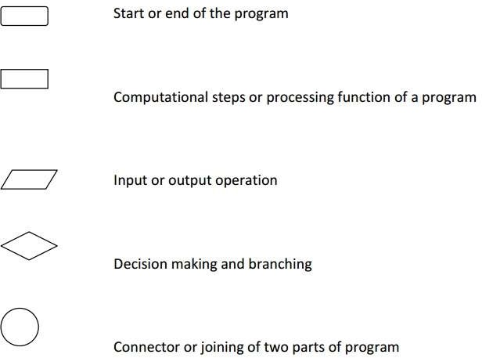
Symbols used in flowchart
Flowcharts are usually drawn using some standard symbols; however, some special symbols can also be developed when required. Some standard symbols, which are frequently required for flowcharting many computer programs.

Slide 43
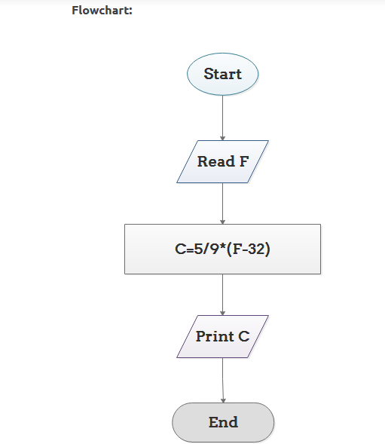
Example of Flowchart

Slide 44
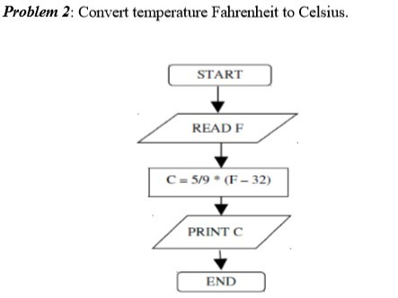
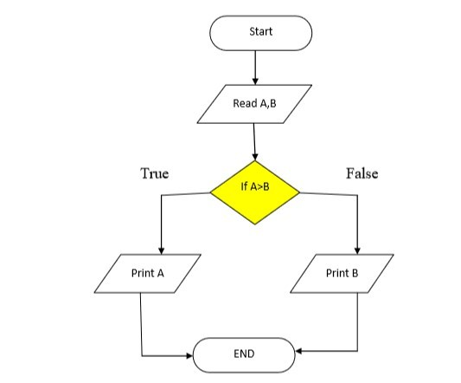
Problem 3: Flowchart to find the greatest from 2 numbers.

Slide 45
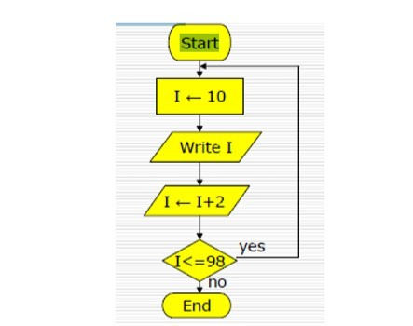
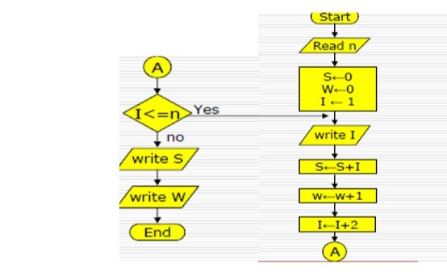
Problem 4: Flowchart to print the Even numbers between 9 and 100.
Problem 5: Flowchart for printing odd numbers less than a given number. It should also calculate their sum and count.

Slide 46
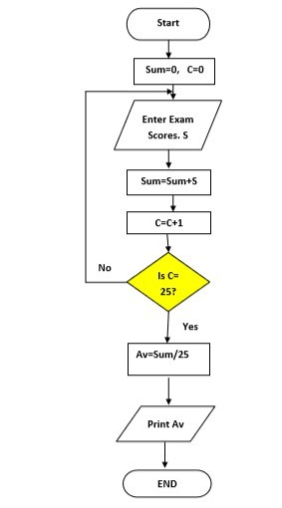
Problem 6 : Flowchart for the calculate the average from 25 exam scores.
Assignments
Draw a flowchart to find the sum of first 100 natural numbers.
Draw a flow chart to find the largest of 3 numbers.
Draw a flowchart for check a given number is prime or not.

Slide 47
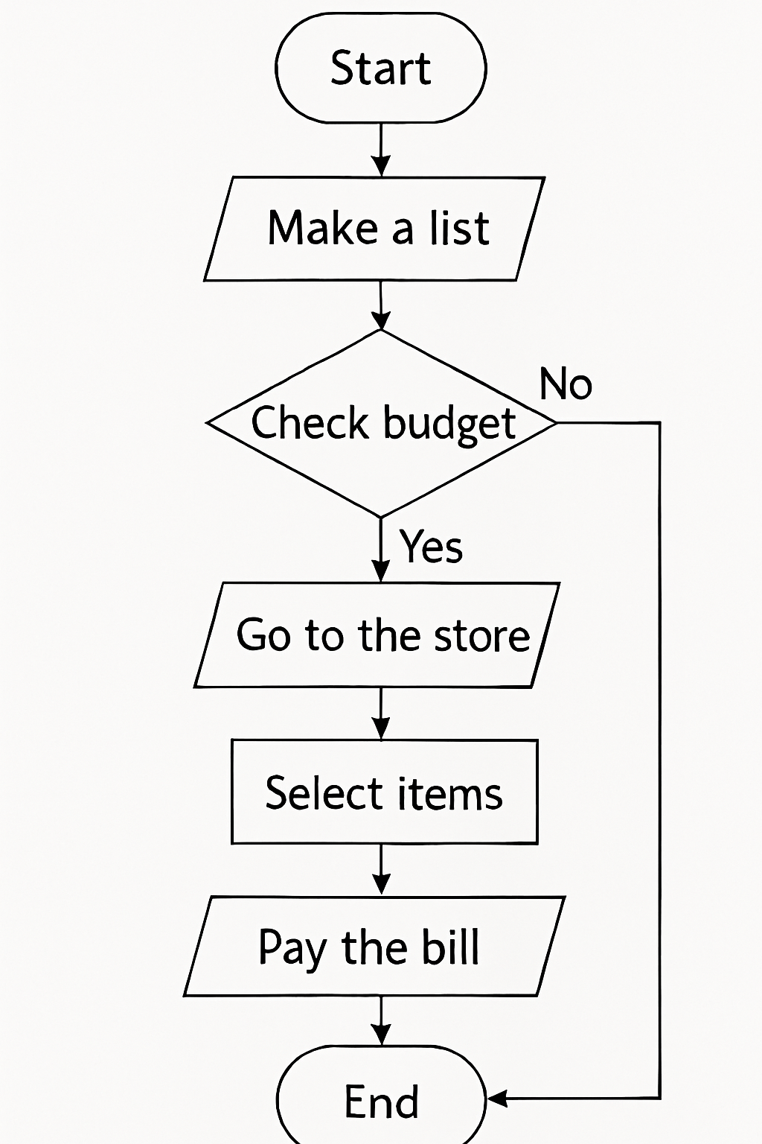
Problem statements from daily life: Buy Stationery for you Exam

Slide 48
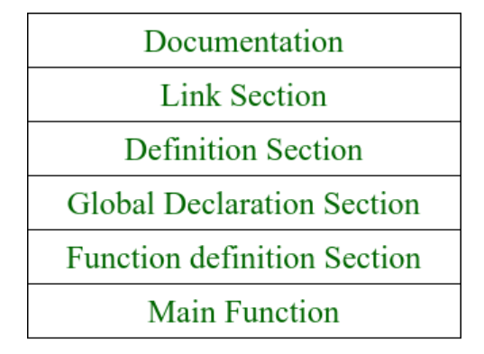
Programming Basics: Structure of a C++ Program

Slide 49
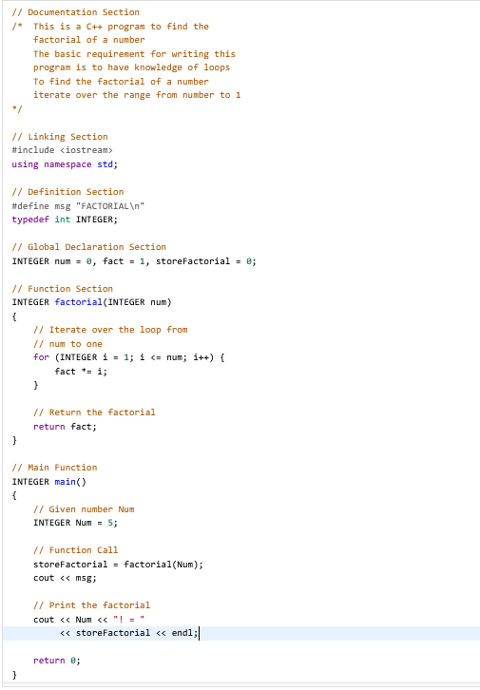

Slide 50
Separate Compilation
Each file of source code
  programming language text
is compiled to produce a file of object code
  binary code, almost executable
  exact addresses of variables and functions not known, represented by symbols
All object code files linked to produce the executable
  Linking mainly consists of replacing symbols by real addresses.

Slide 52
"Hello World!" of C++
#include <iostream.h>
void main()
{
std::cout << "Hello, World!" << std::endl;
}
#include <iostream.h>
Using namespace std;
int main()
{
cout << "Hello, World!" << std::endl;
return 0;
}

Slide 53
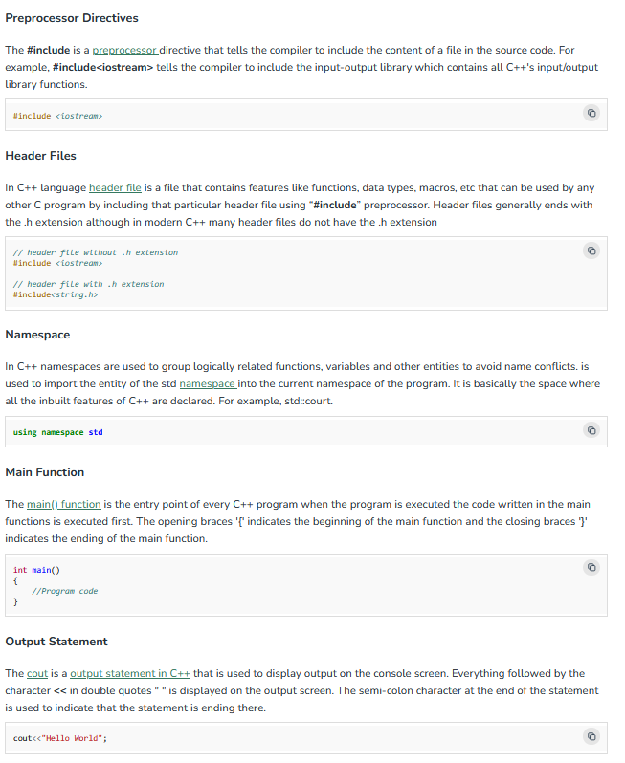
Basic Components of a Simple C++ Program

Slide 54
Basic Components of a Simple C++ Program

Slide 55
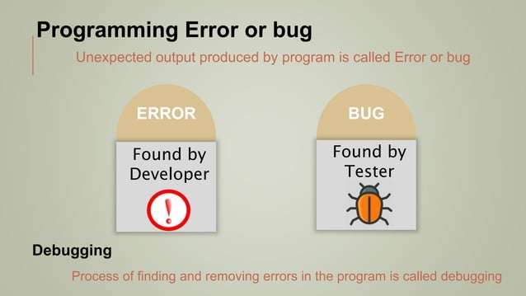

Slide 56
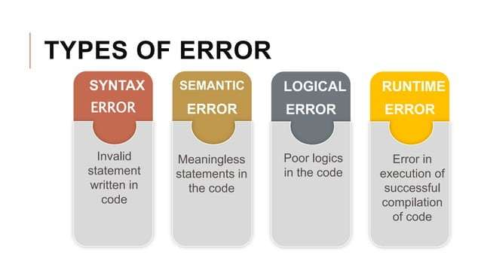

Slide 57
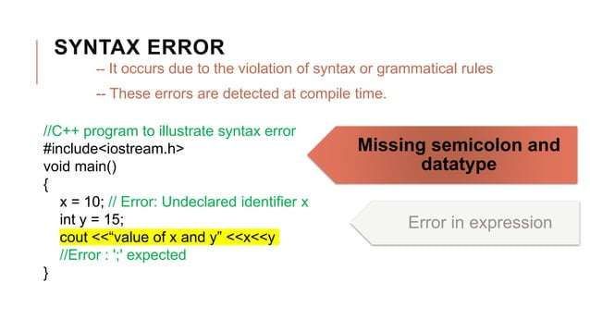

Slide 58
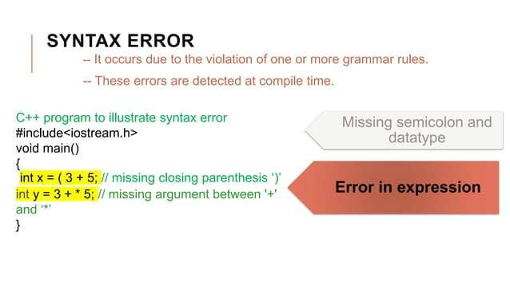

Slide 59
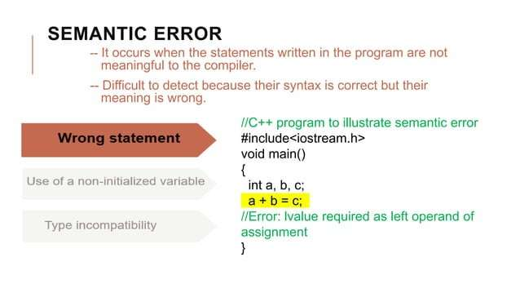

Slide 60
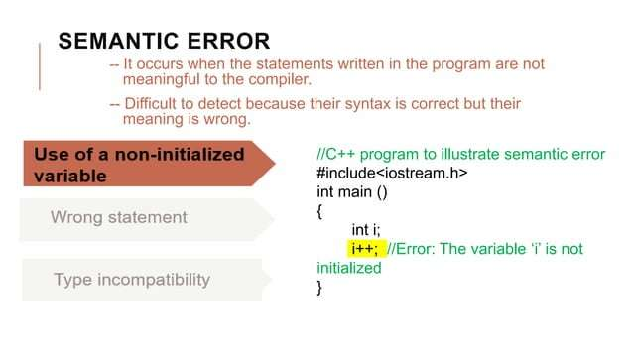

Slide 61
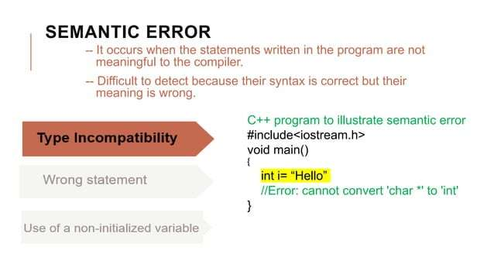

Slide 62
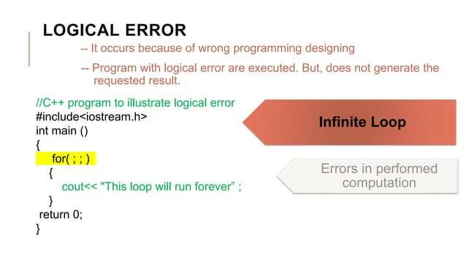

Slide 63
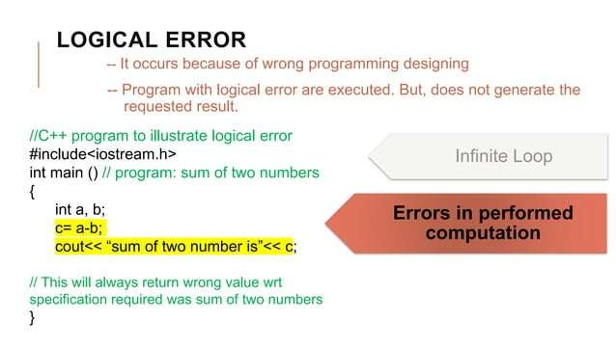

Slide 64
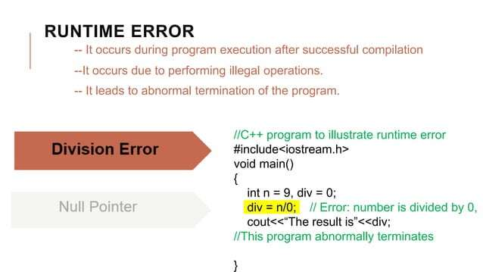

Slide 65
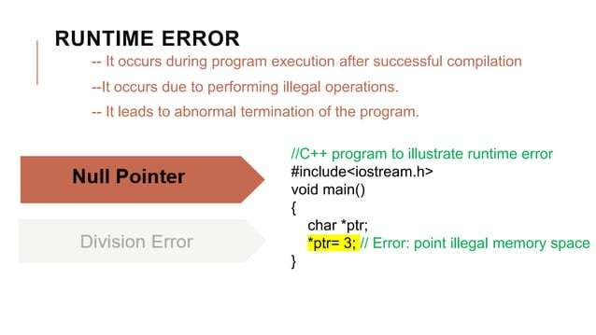

Slide 66
Reference
https://www.geeksforgeeks.org/
https://techvidvan.com/
https://www.tutorialspoint.com/cplusplus

